Slide 1
Chapter 13 JavaFX GUI : Part 2

Slide 2
13.1 Introduction
In this chapter, you’ll:
Use additional layouts (TitledPane, BorderPane and Pane) and controls (RadioButton and ListView).
Handle mouse and RadioButton events.
Set up event handlers that respond to property changes on controls(such as the value of a Slider).
Display Rectangles and Circles as nodes in the scene graph.
Bind a collection of objects to a ListView that displays the collection’s contents.
Customize the appearance of a ListView’s cells.

Slide 3
13.2 Laying Out Nodes in a Scene Graph
A layout determines the size and positioning of nodes in the scene graph.
Node Size
In general, a node’s size should not be defined explicitly.
Doing so often creates a design that looks pleasing when it first loads, but deteriorate(恶化） when the app is resized or the content updates.

Slide 4
13.2 Laying Out Nodes in a Scene Graph
most JavaFX nodes have the properties width, height, prefWidth, prefHeight, minWidth, minHeight, maxWidth and maxHeight
minimum size: a node’s smallest allowed size in points.
maximum size:a node’s largest allowed size in points.
preferred size :a node’s preferred width and height that should be used by the layout in most cases.

Slide 5
13.2 Laying Out Nodes in a Scene Graph
Pane
JavaFX layout panes are container nodes that arrange their child nodes in a scene graph relative to one another, based on their sizes and positions.
Most JavaFX layout panes use relative positioning—if a layout-pane node is resized, it adjusts its children’s sizes and positions accordingly, based on their preferred, minimum and maximum sizes.

Slide 6
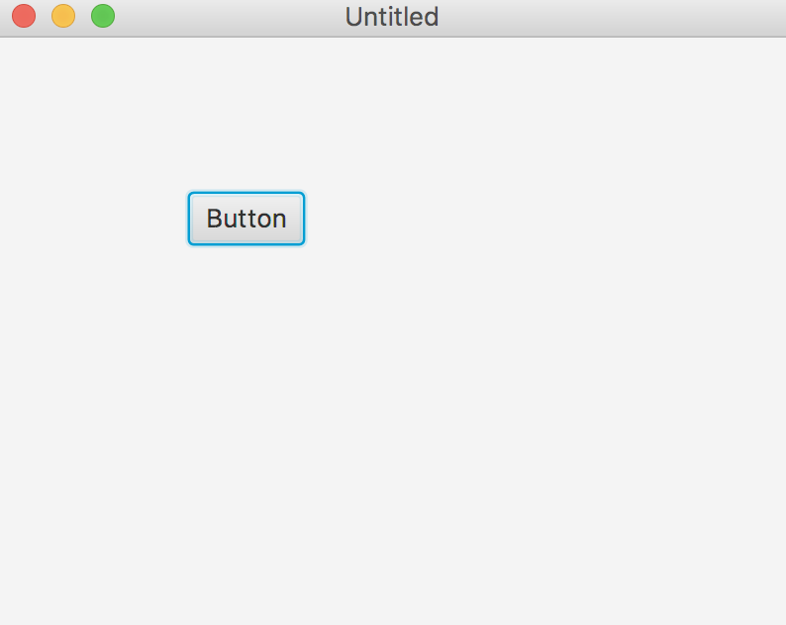
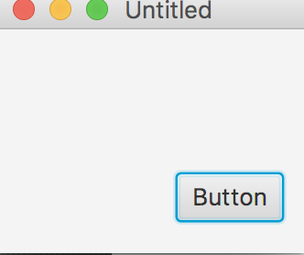
13.2 Laying Out Nodes in a Scene Graph
AnchorPane
Enables you to set the position of child nodes relative to the pane’s edges. Resizing the pane does not alter the layout of the nodes.

Slide 7
13.2 Laying Out Nodes in a Scene Graph
Example：
AnchorPane anchorPane = new AnchorPane();
// List should stretch as anchorPane is resized
ListView list = new ListView(); AnchorPane.setTopAnchor(list, 10.0); AnchorPane.setLeftAnchor(list, 10.0); AnchorPane.setRightAnchor(list, 65.0);
// Button will float on right edge
Button button = new Button("Add"); AnchorPane.setTopAnchor(button, 10.0); AnchorPane.setRightAnchor(button, 10.0); anchorPane.getChildren().addAll(list, button);

Slide 8
13.2 Laying Out Nodes in a Scene Graph
BorderPane
Includes five areas—top, bottom, left, center and right— where you can place nodes. The top and bottom regions fill the BorderPane’s width and are vertically sized to their children’s preferred heights. The left and right regions fill the BorderPane’s height and are horizontally sized to their children’s preferred widths. The center area occupies all of the BorderPane’s remaining space. You might use the different areas for tool bars, navigation, a main content area, etc.

Slide 9
13.2 Laying Out Nodes in a Scene Graph
Example：
BorderPane borderPane = new BorderPane();
ToolBar toolbar = new ToolBar();
HBox statusbar = new HBox();
Button button = new Button(); borderPane.setTop(toolbar); borderPane.setCenter(button); borderPane.setBottom(statusbar);

Slide 10
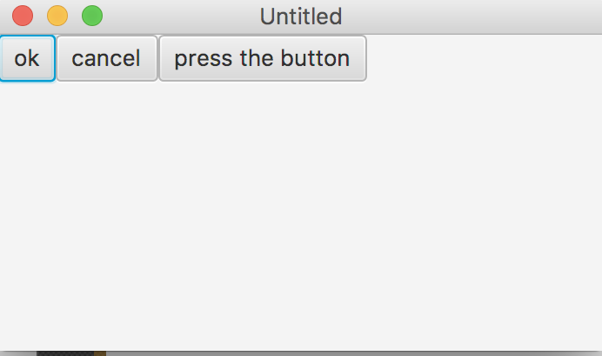
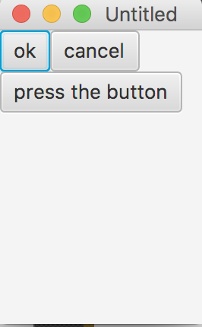
13.2 Laying Out Nodes in a Scene Graph
FlowPane：
Lays out nodes consecutively—either horizontally or vertically. When the boundary for the pane is reached, the nodes wrap to a new line in a horizontal FlowPane or a new column in a vertical FlowPane.

Slide 11
13.2 Laying Out Nodes in a Scene Graph
Example：
Image images[] = { ... };
FlowPane flow = new FlowPane();
flow.setVgap(8);
flow.setHgap(4);
flow.setPrefWrapLength(300); // preferred width = 300
for (int i = 0; i < images.length; i++) { flow.getChildren().add(new ImageView(image[i]); }

Slide 12
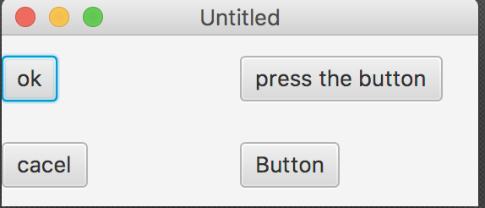
13.2 Laying Out Nodes in a Scene Graph
GridPane：
Creates a flexible grid for laying out nodes in rows and columns.

Slide 13
13.2 Laying Out Nodes in a Scene Graph
Example：
GridPane gridpane = new GridPane(); gridpane.add(new Button(), 1, 0); // column=1 row=0
gridpane.add(new Label(), 2, 0); // column=2 row=0

Slide 14
GridPane gridpane = new GridPane();
// Set one constraint at a time...
// Places the button at the first row and second column Button button = new Button();
GridPane.setRowIndex(button, 0); GridPane.setColumnIndex(button, 1);
// or convenience methods set more than one constraint at once...
Label label = new Label();
GridPane.setConstraints(label, 2, 0);
// column=2 row=0 // don't forget to add children to gridpane
gridpane.getChildren().addAll(button, label);

Slide 15
13.2 Laying Out Nodes in a Scene Graph
Pane：
The base class for layout panes. This can be used to position nodes at fixed locations—known as absolute positioning.

Slide 16
13.2 Laying Out Nodes in a Scene Graph
Example：
Pane canvas = new Pane(); canvas.setPrefSize(200,200);
Circle circle = new Circle(50,Color.BLUE);
circle.relocate(20, 20);
Rectangle rectangle = new Rectangle(100,100,Color.RED); rectangle.relocate(70,70); canvas.getChildren().addAll(circle,rectangle);

Slide 17
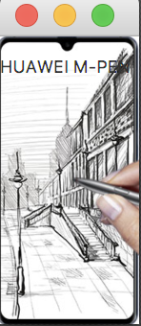
13.2 Laying Out Nodes in a Scene Graph
StackPane：
Places nodes in a stack. Each new node is stacked atop the previous node. You might use this to place text on top of images, for example.

Slide 18
13.2 Laying Out Nodes in a Scene Graph
Example：
// Align the title Label at the bottom-center of the stackpane
Label title = new Label();
StackPane.setAlignment(title, Pos.BOTTOM_CENTER); stackpane.getChildren.addAll(new ImageView(...), title);
// Create an 8 pixel margin around a listview in the stackpane
ListView list = new ListView();
StackPane.setMargin(list, new Insets(8,8,8,8);
stackpane.getChildren().add(list);

Slide 19
13.2 Laying Out Nodes in a Scene Graph
TilePane：
A horizontal or vertical grid of equally sized tiles. Nodes that are tiled horizontally wrap at the TilePane’s width. Nodes that are tiled vertically wrap at the TilePane’s height.

Slide 20
13.2 Laying Out Nodes in a Scene Graph
Example：
TilePane tile = new TilePane();
tile.setHgap(8);
tile.setPrefColumns(4);
for (int i = 0; i < 20; i++) { tile.getChildren().add(new ImageView(...)); }

Slide 21
13.2 Laying Out Nodes in a Scene Graph
Example：
TilePane tile = new TilePane(Orientation.VERTICAL); tile.setTileAlignment(Pos.CENTER_LEFT); tile.setPrefRows(10);
for (int i = 0; i < 50; i++) { tile.getChildren().add(new Button(...)); }

Slide 22
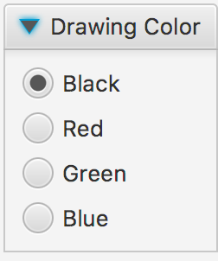
13.2 Laying Out Nodes in a Scene Graph
TitlePane：
A TitledPane is a panel with a title that can be opened and closed.

Slide 23
13.2 Laying Out Nodes in a Scene Graph
Example：
TitledPane titledPane = new TitledPane("My Title", new CheckBox("OK"));
final String[] imageNames = new String[]{"Apples", "Flowers", "Leaves"};
final Image[] images = new Image[imageNames.length];
final ImageView[] pics = new ImageView[imageNames.length];
final TitledPane[] tps = new TitledPane[imageNames.length];
@Override public void start(Stage stage) {
……
final Accordion accordion = new Accordion ();
for (int i = 0; i < imageNames.length; i++) {
images[i] = new
Image(getClass().getResourceAsStream(imageNames[i] + ".jpg"));
pics[i] = new ImageView(images[i]);
tps[i] = new TitledPane(imageNames[i],pics[i]);
}
accordion.getPanes().addAll(tps);
accordion.setExpandedPane(tps[0]);
在一个Accordion中同一时间只能打开一个Titled Pane

Slide 24
13.2 Laying Out Nodes in a Scene Graph
HBox：
Arranges nodes horizontally in one row.
VBox
Arranges nodes vertically in one column.

Slide 25
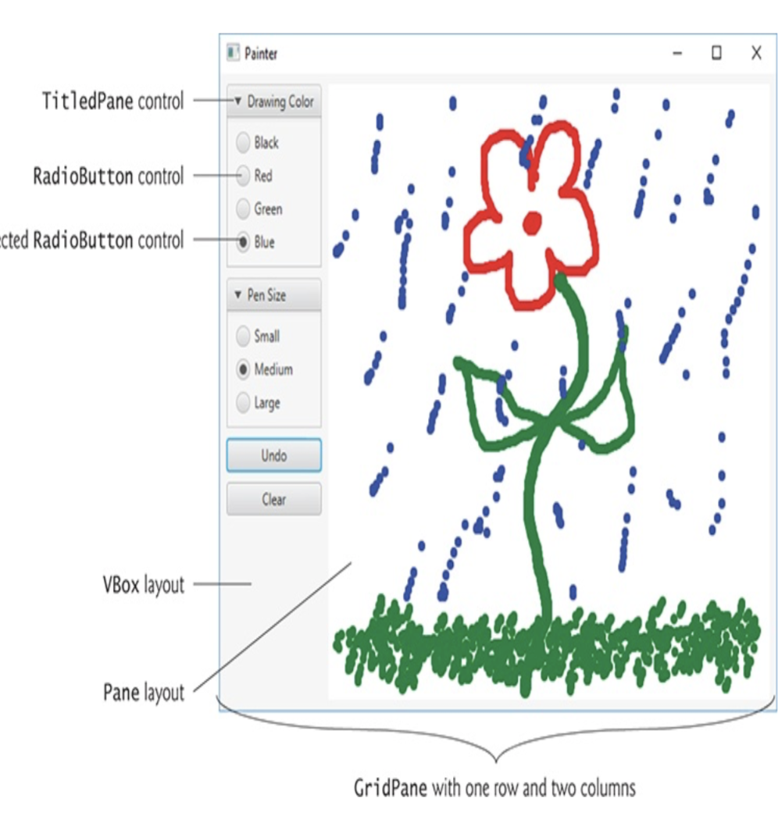
13.3 Painter App: RadioButtons, Mouse Events and Shapes

Slide 26
13.3 Painter App: RadioButtons, Mouse Events and Shapes(Cont.)
RadioButtons and ToggleGroups
RadioButtons function as mutually exclusive options.
You add multiple RadioButtons to a ToggleGroup to ensure that only one RadioButton in a given group is selected at a time.
TitledPane Layout Container
A TitledPane layout container displays a title at its top and is a collapsible panel containing a layout node, which in turn contains other nodes.

Slide 27
13.3 Painter App: RadioButtons, Mouse Events and Shapes(Cont.)
JavaFX Shapes
The javafx.scene.shape package contains various classes for creating 2D and 3D shape nodes that can be displayed in a scene graph.

Slide 28
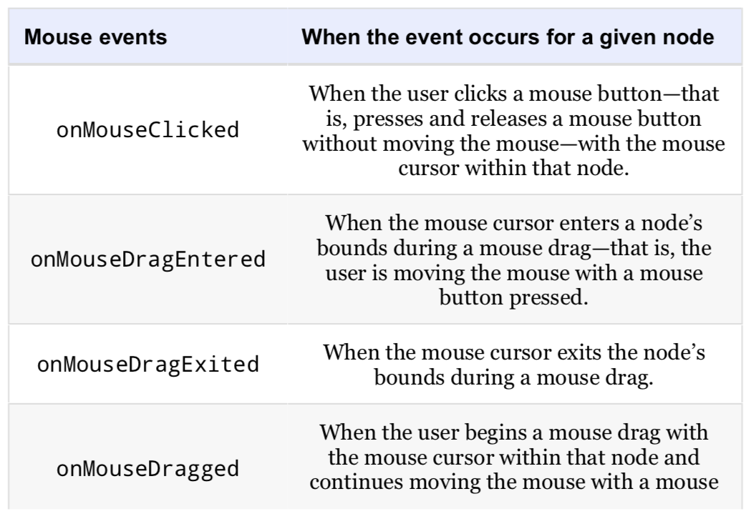
13.3 Painter App: RadioButtons, Mouse Events and Shapes(Cont.)
Mouse Event Handling

Slide 29
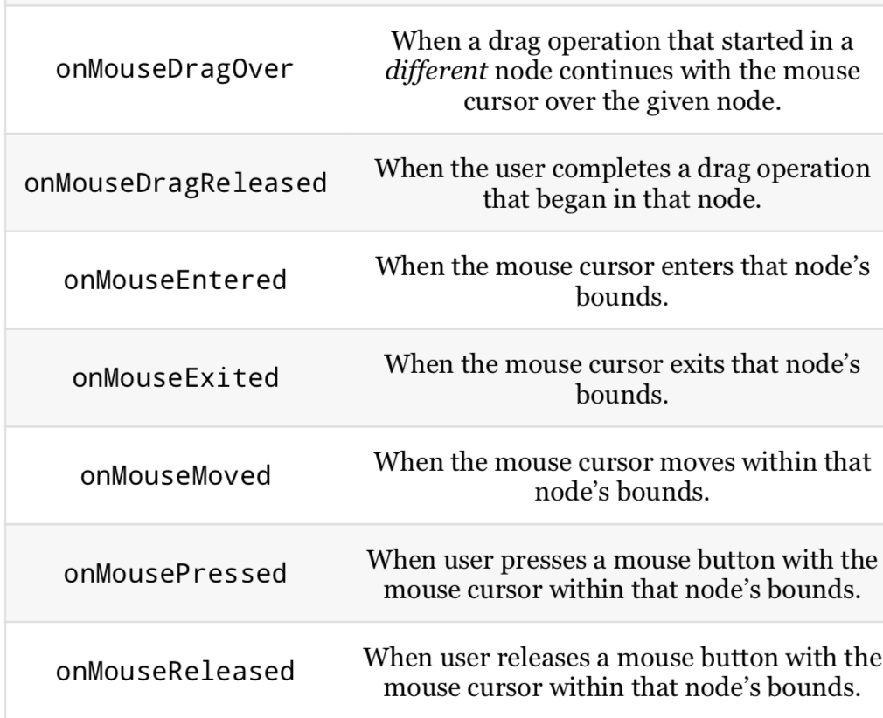

Slide 30
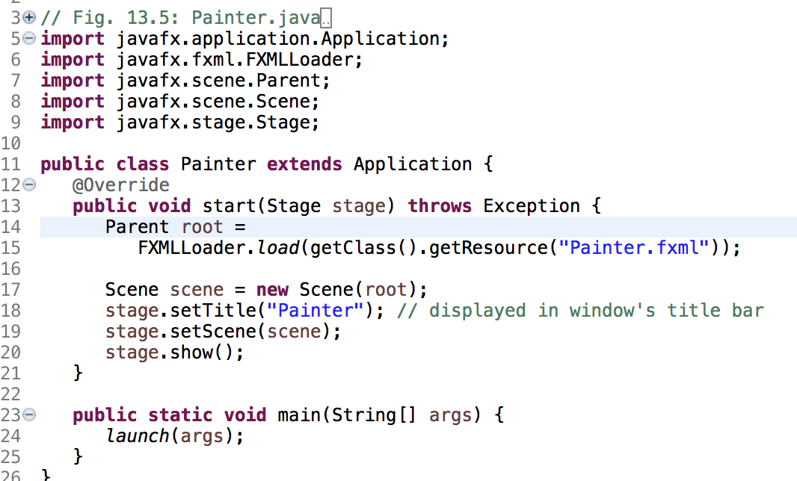

Slide 31
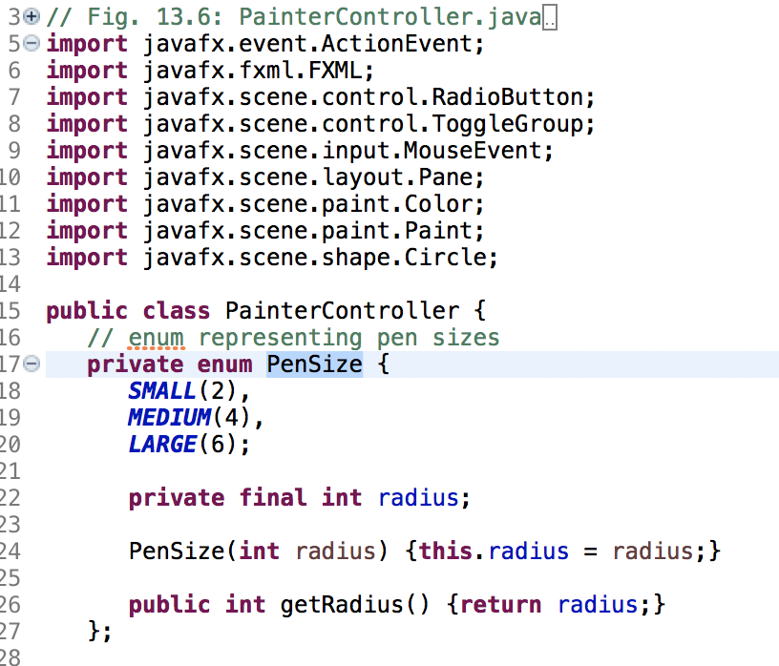

Slide 32
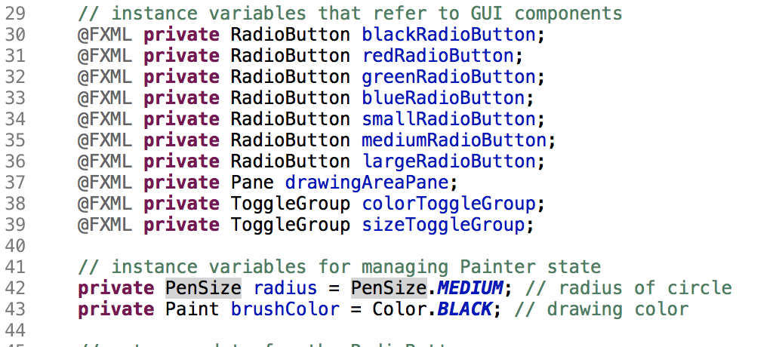

Slide 33
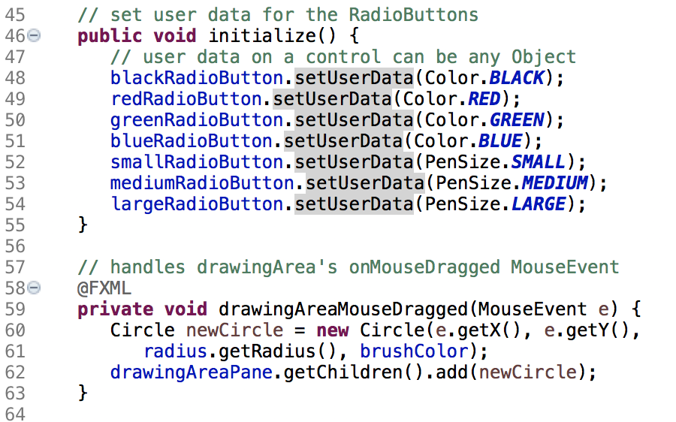
When the FXMLLoader creates a controller- class object, FXMLLoader determines whether the class contains an initialize method with no parameters and, if so, calls that method to initialize the controller.

Slide 34
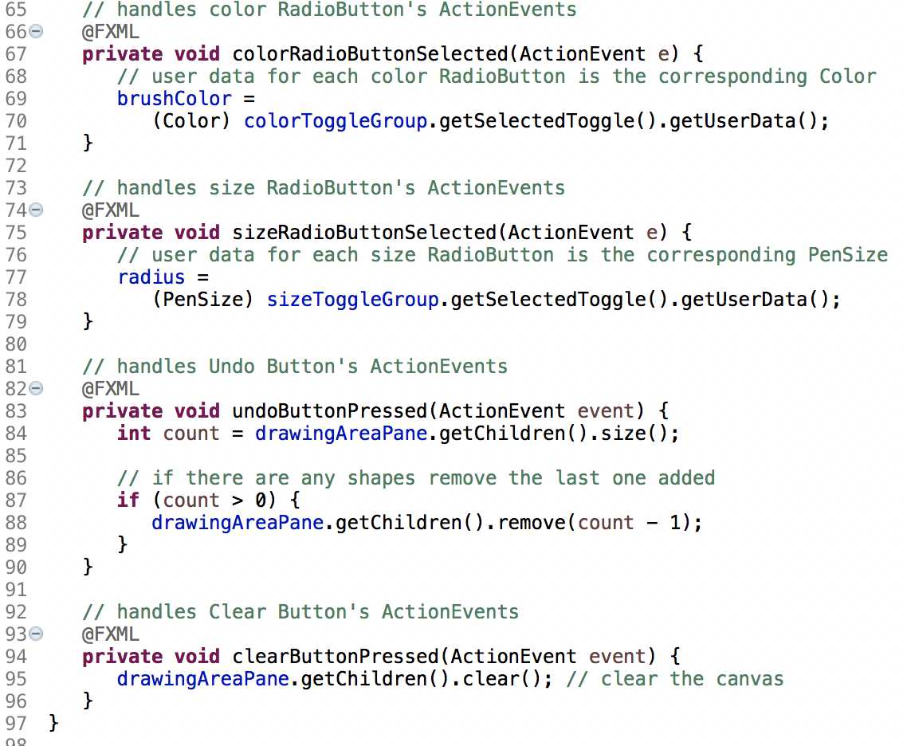

Slide 35
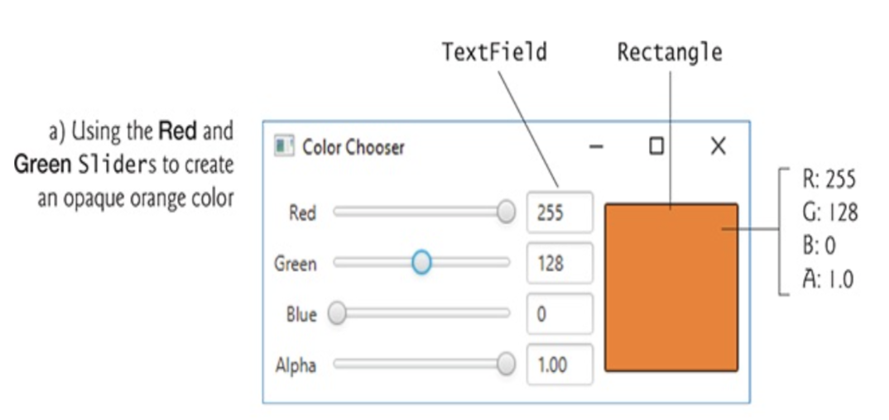
13.4 Color Chooser App: Property Bindings and Property Listeners

Slide 36
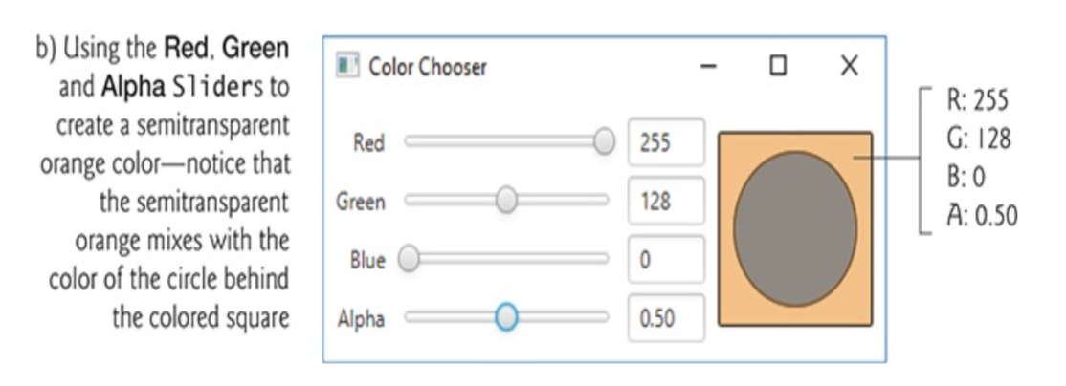
13.4 Color Chooser App: Property Bindings and Property Listeners(Cont.)

Slide 37
13.4 Color Chooser App: Property Bindings and Property Listeners(Cont.)
RGBA color system
every color is represented by its red, green and blue color values, each ranging from 0 to 255, where 0 denotes no color and 255 full color.
The alpha value (A)—which ranges from 0.0 to 1.0— represents a color’s opacity, with 0.0 being completely transparent and 1.0 completely opaque

Slide 38
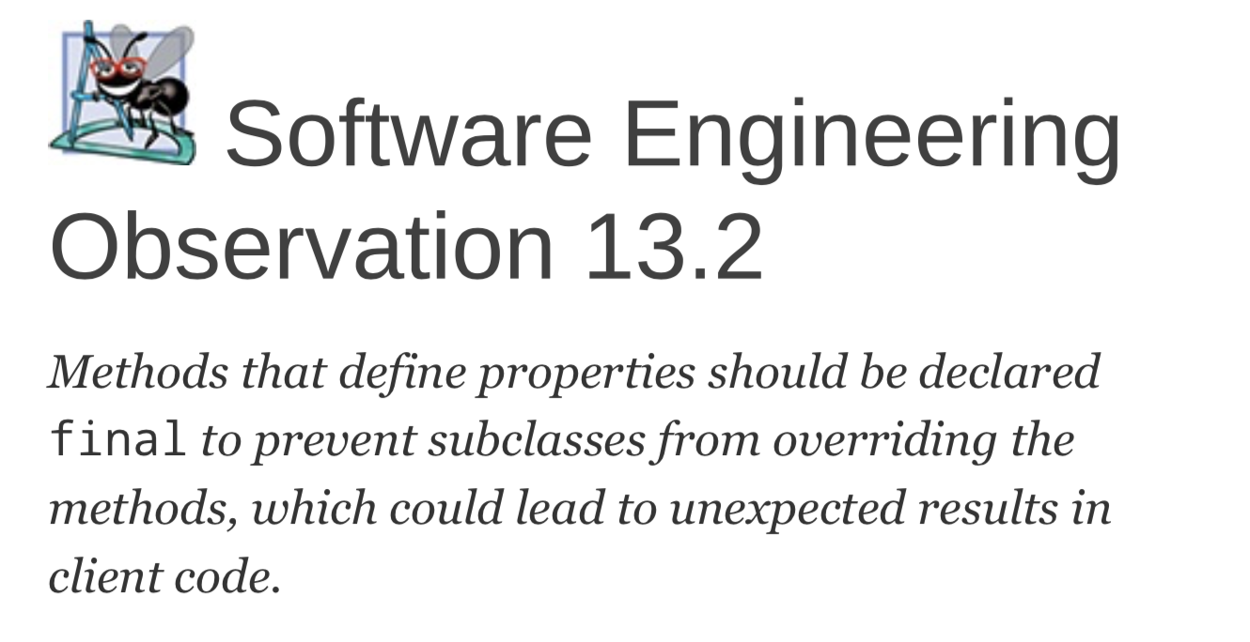
13.4 Color Chooser App: Property Bindings and Property Listeners(Cont.)
A property is defined by creating set and get methods with specific naming conventions.

Slide 39
13.4 Color Chooser App: Property Bindings and Property Listeners(Cont.)
Property binding
JavaFX properties are implemented in a manner that makes them observable—when a property’s value changes, other objects can respond accordingly.
Package javafx.beans.property contains many classes that you can use to define bindable properties in your own classes.
redTextField.textProperty().bind(
redSlider.valueProperty().asString("%.0f"));

Slide 40
13.4 Color Chooser App: Property Bindings and Property Listeners(Cont.)
Property Listeners
A property listener is an event handler that’s invoked when a property’s value changes.
redSlider.valueProperty().addListener(
new ChangeListener<Number>() {
@Override
public void changed(ObservableValue<? extends Number> ov, Number oldValue, Number newValue) {
red=newValue.intValue();
colorRectangle.setFill(Color.rgb(red, green, blue, alpha));
}
}
);

Slide 41
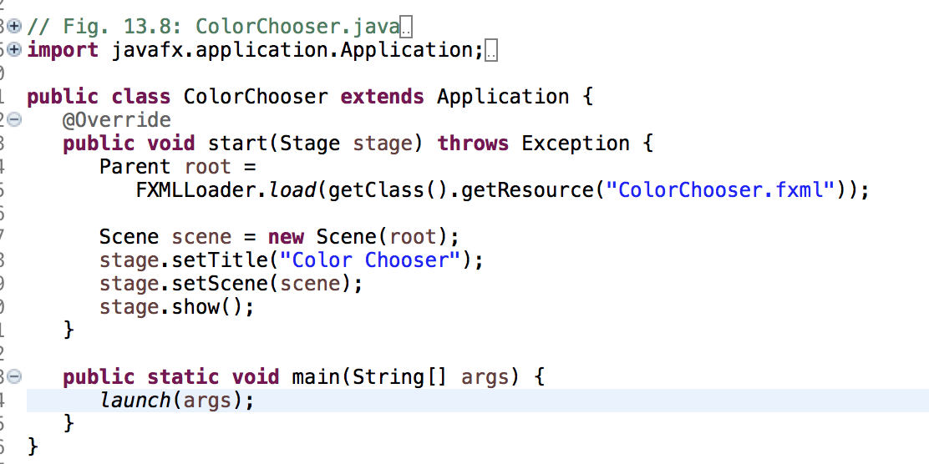
13.4 Color Chooser App: Property Bindings and Property Listeners(Cont.)

Slide 42
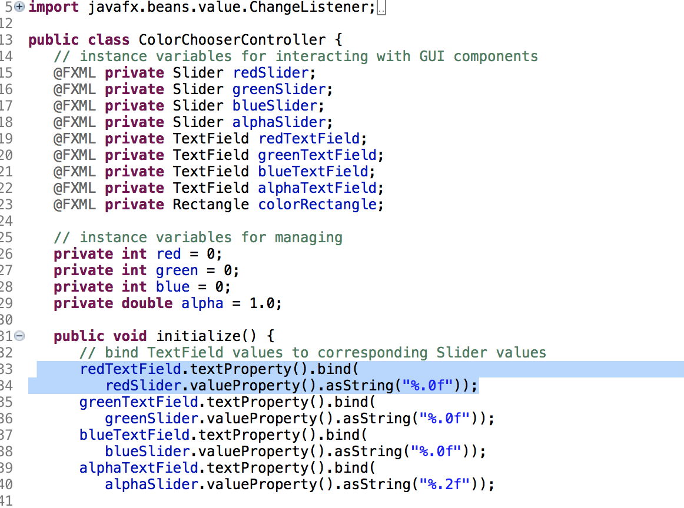
13.4 Color Chooser App: Property Bindings and Property Listeners(Cont.)

Slide 43
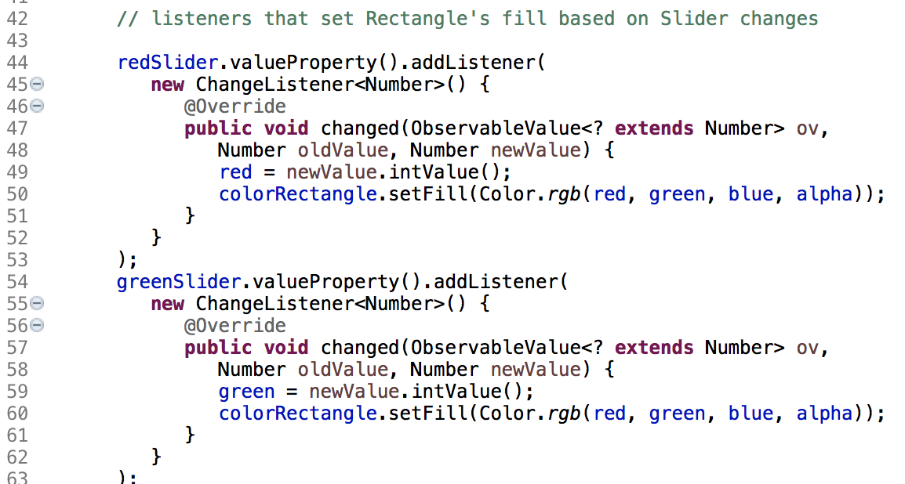
13.4 Color Chooser App: Property Bindings and Property Listeners(Cont.)

Slide 44
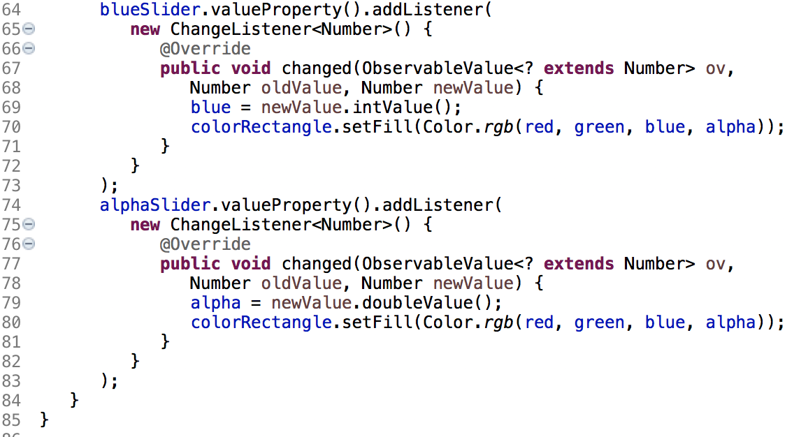
13.4 Color Chooser App: Property Bindings and Property Listeners(Cont.)

Slide 45
13.5 Cover Viewer App: Data-Driven GUIs with JavaFX Collections
Often an app needs to edit and display data.
JavaFX provides a comprehensive model for allowing GUIs to interact with data.

Slide 46
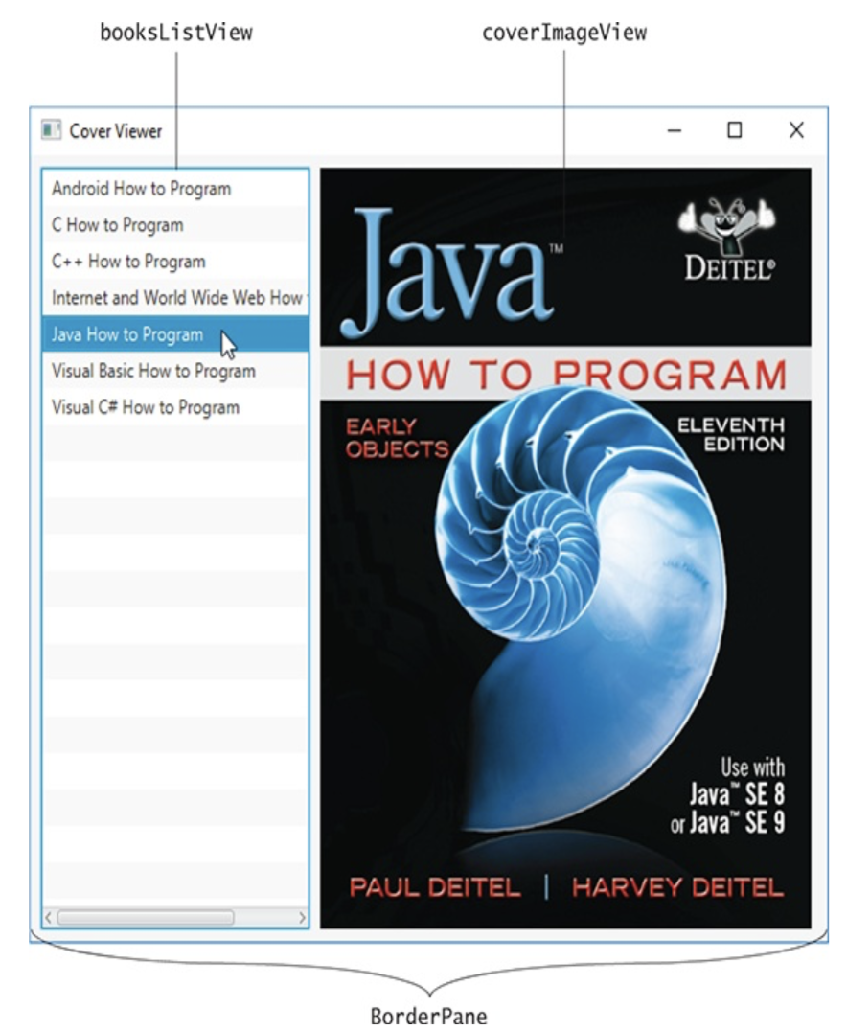
13.5 Cover Viewer App: Data-Driven GUIs with JavaFX Collections(Cont.)

Slide 47
13.5 Cover Viewer App: Data-Driven GUIs with JavaFX Collections(Cont.)
For the ListView, set the following properties:
Margin—8 (for the right margin) to separate the ListView from the ImageView
Pref Width—200
Max Height—MAX_VALUE
Min Width, Min Height, Pref Height and Max Width —USE_COMPUTED_SIZE

Slide 48
13.5 Cover Viewer App: Data-Driven GUIs with JavaFX Collections(Cont.)
For the ImageView, set the following properties:
Fit Width and Fit Height — 370 and 480
For the BorderPane, set the following properties:
Pref Width and Pref Height —USE_COMPUTED_SIZE
Padding —8

Slide 49
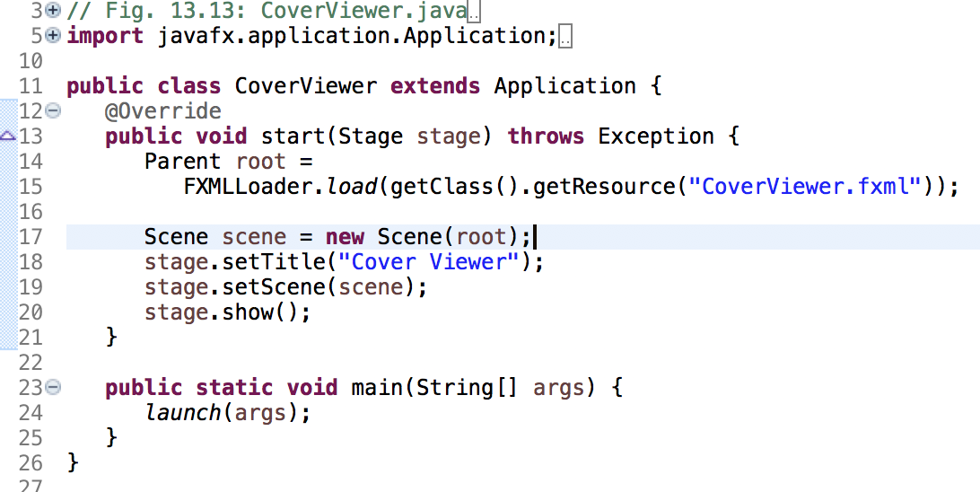

Slide 50
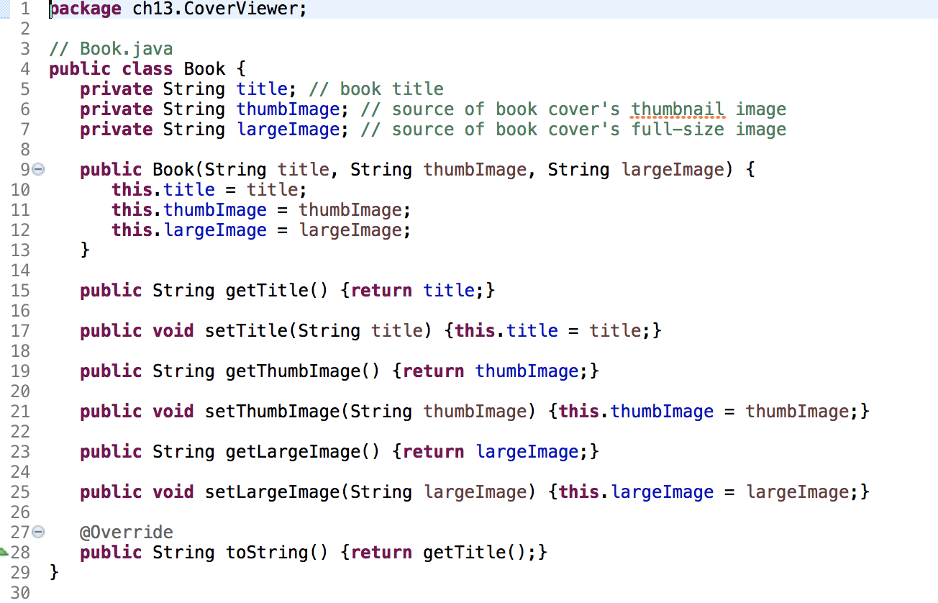

Slide 51
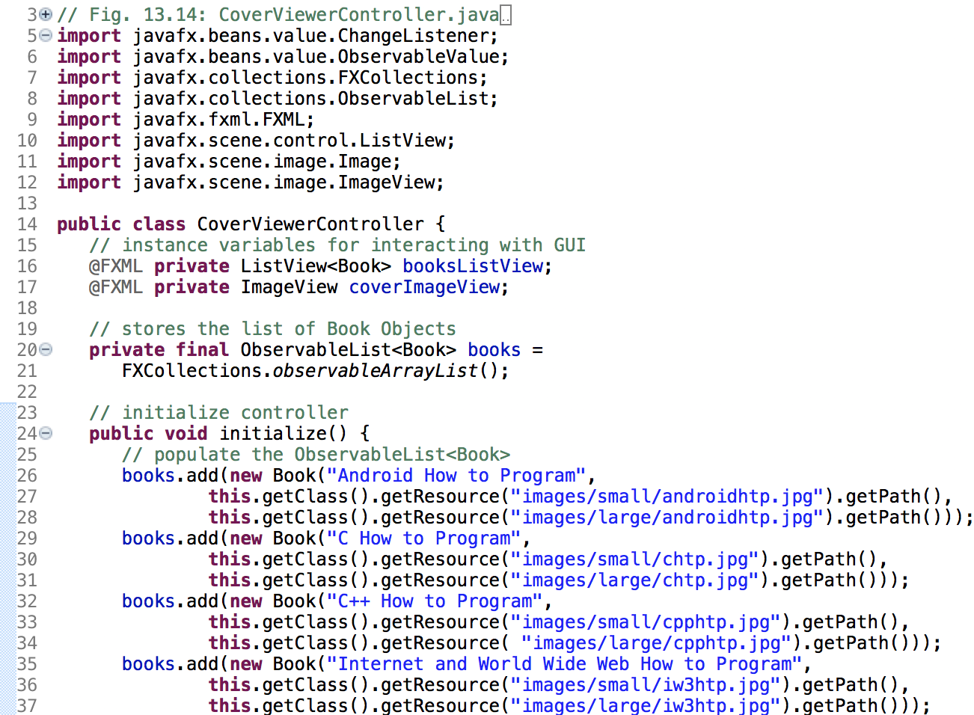

Slide 52
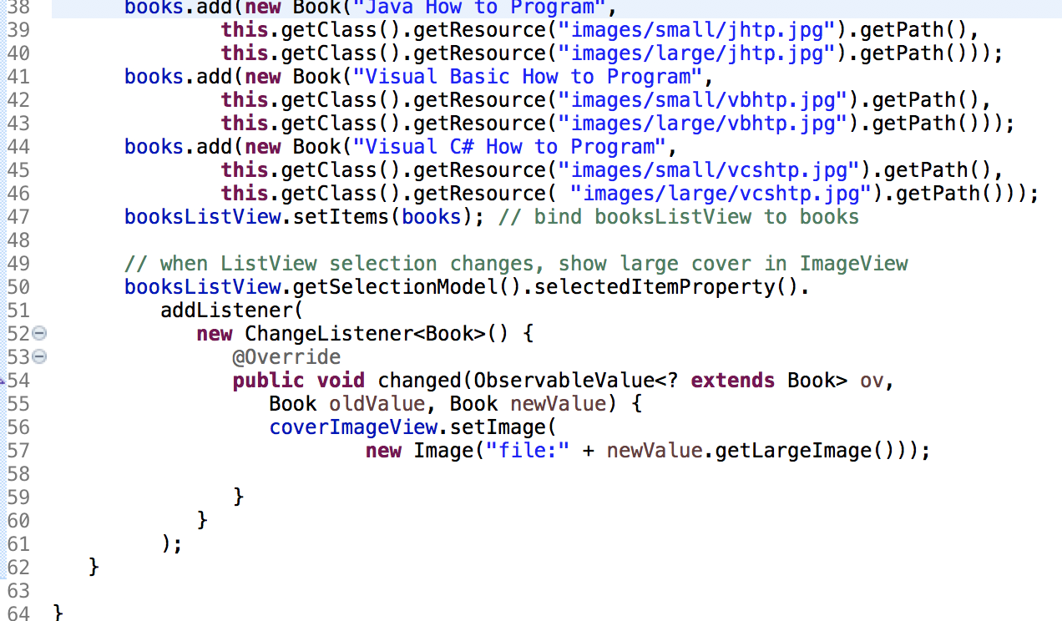

Slide 53
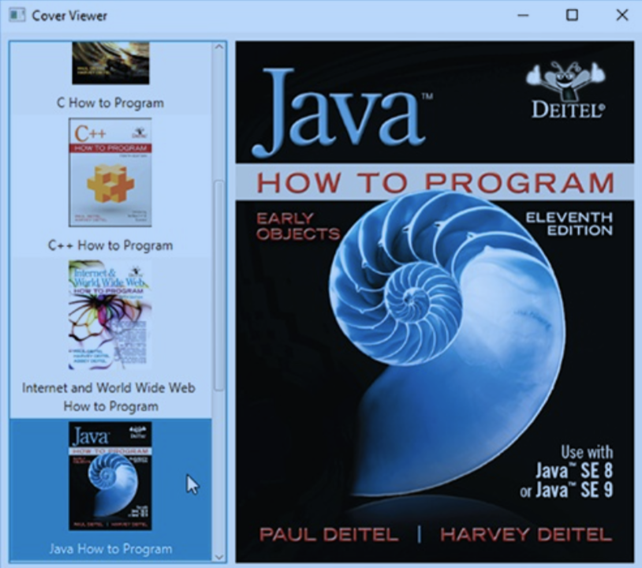
13.6 Cover Viewer App: Customizing ListView Cells

Slide 54
13.6 Cover Viewer App: Customizing ListView Cells
ListView cells display the String representations of a ListView’s items by default.
To create a custom cell format, you must first define a subclass of the ListCell generic class (package javafx.scene.control) that specifies how to create a ListView cell.
Use the ListView’s setCellFactory method to replace the default cell factory with one that returns objects of the ListCell subclass.

Slide 55
13.6 Cover Viewer App: Customizing ListView Cells
Programmatically Creating Layouts and Controls
In this app, you’ll also create a portion of the GUI programmatically—in fact, everything we’ve shown you in Scene Builder also can be accomplished in Java code directly.

Slide 56
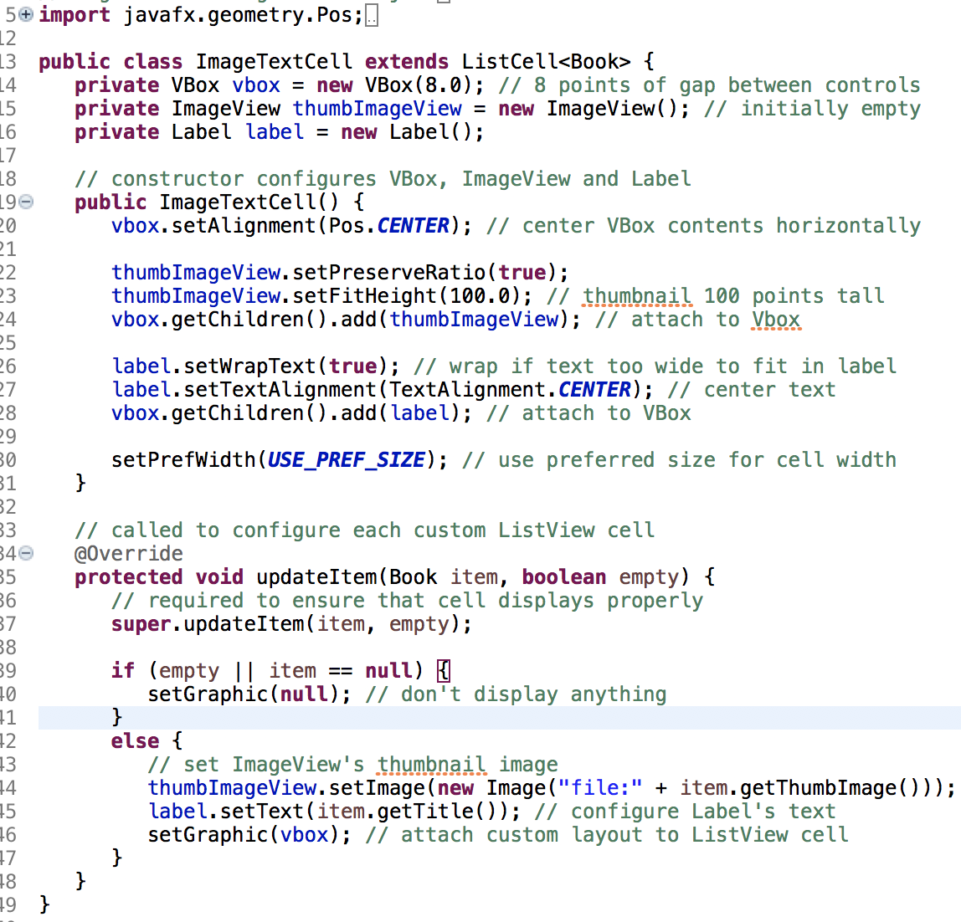

Slide 57
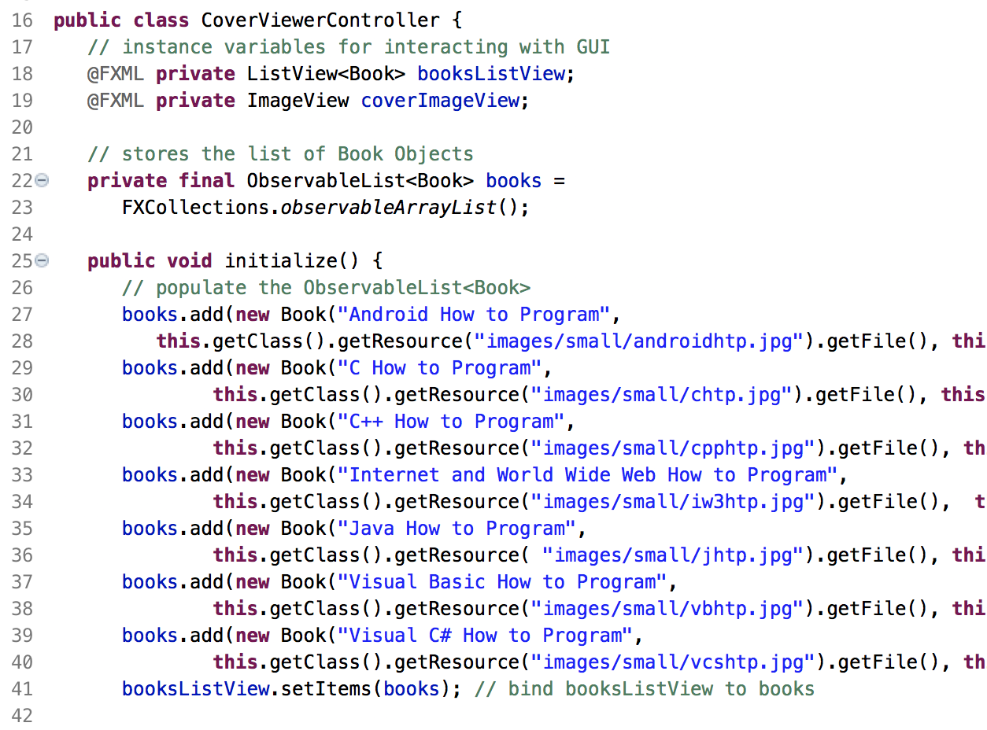

Slide 58
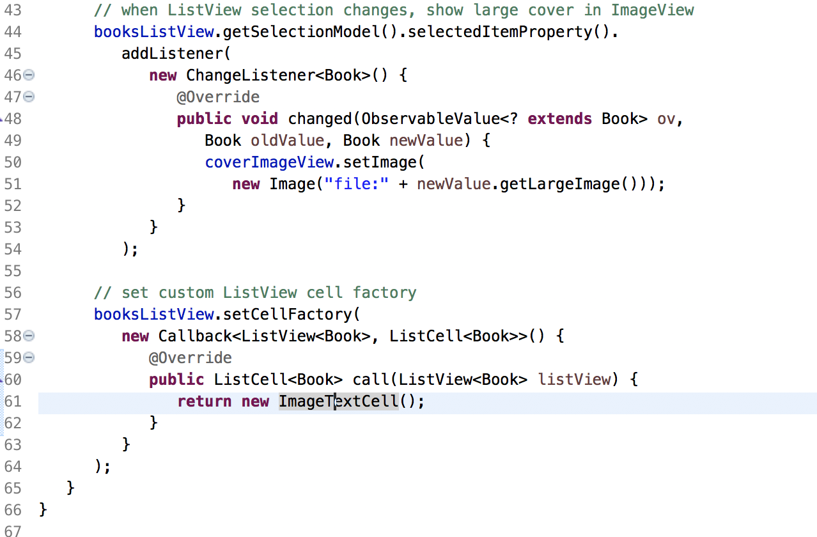

Slide 59
13.7 Additional JavaFX Capabilities
TableView
JavaFX’s TableView control (package javafx.scene.control) displays tabular data in rows and columns, and supports user interactions with that data.
Example: http://www.javafxchina.net/blog/2015/04/doc03_tableview/

Slide 60
13.7 Additional JavaFX Capabilities(Cont.)
Accessibility
In a Java SE 8 update, JavaFX added accessibility features to help people with visual impairments use their devices.

Slide 61
13.7 Additional JavaFX Capabilities(Cont.)
Third-Party JavaFX Libraries
ControlsFX
http://www.controlsfx.org/
JFXtras
http://jfxtras.org/
Medusa
https://github.com/HanSolo/Medusa/blob/master/README.md.

Slide 62
13.7 Additional JavaFX Capabilities(Cont.)
Creating Custom JavaFX Controls
We can create custom controls by extending existing JavaFX control classes to customize them or by extending JavaFX’s Control class directly.

Slide 63
13.8 Multiple Stages
Project TwoStages
Project TwoControllers

